Slide 1
校園冒險故事

Slide 2
1.目標
Notes:
https://unsplash.com/photos/desktop-monitor-beside-computer-tower-on-inside-room-NaqHdUS5mno

Slide 3
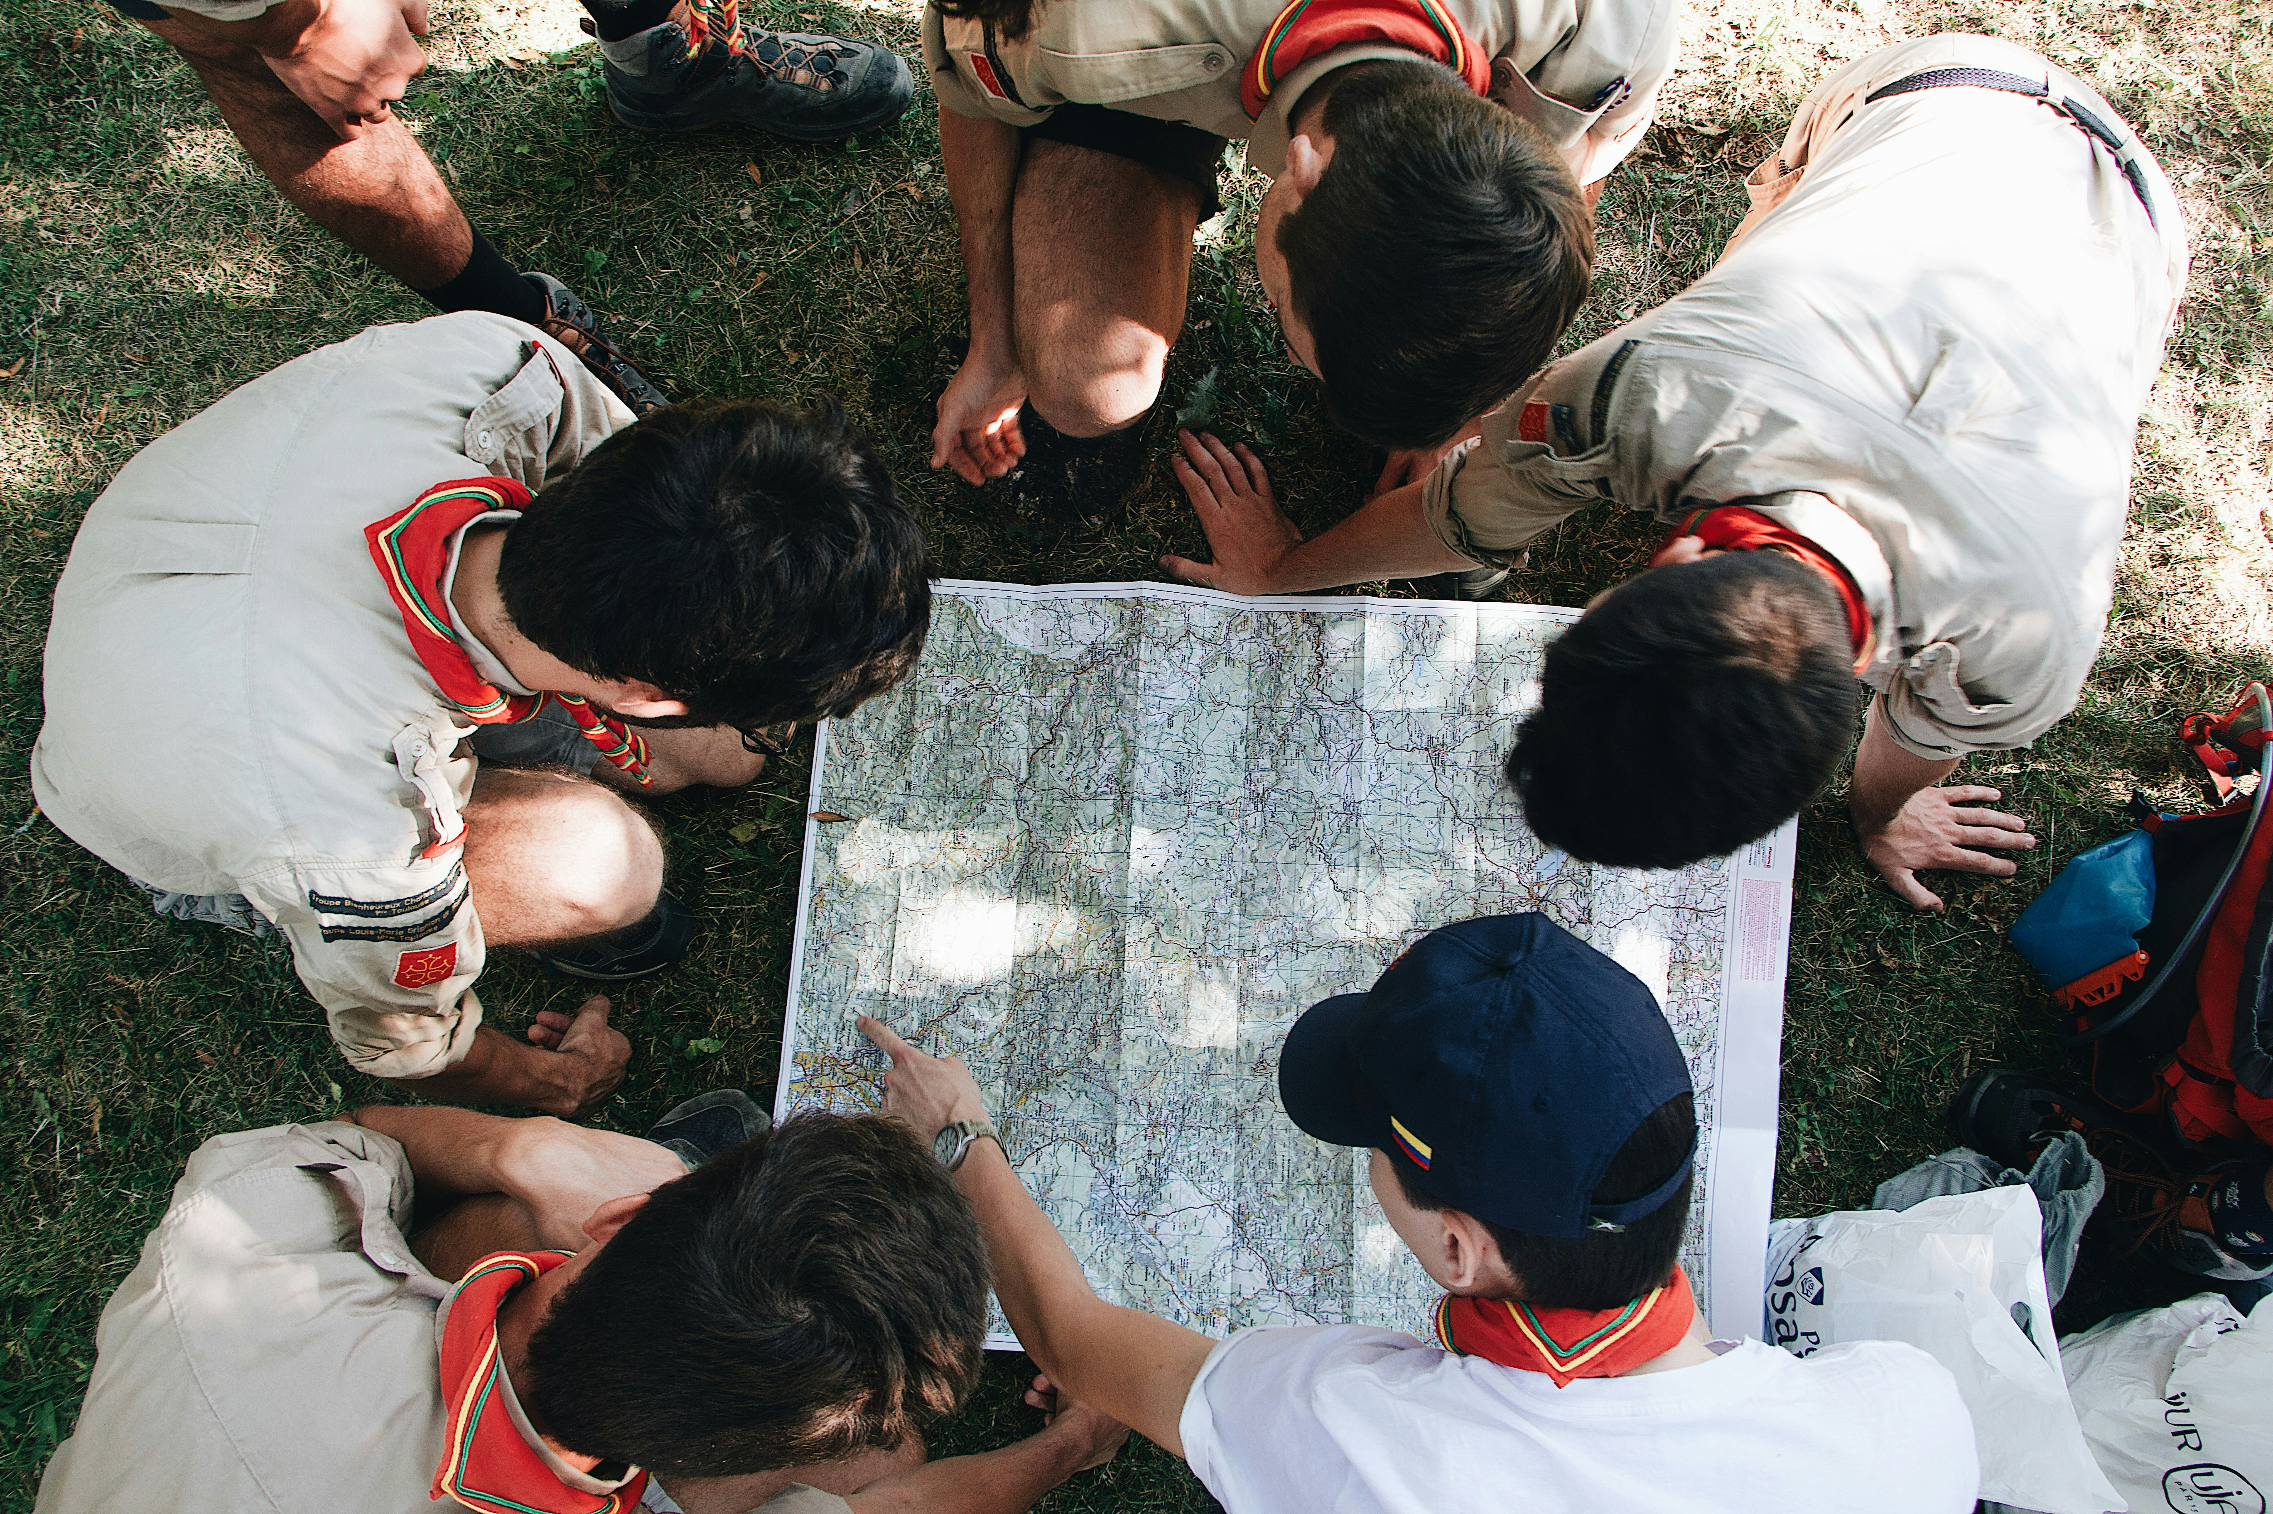
2.阻礙
Notes:
https://unsplash.com/photos/people-sitting-on-green-grass-field-during-daytime-7rImz-goqfQ

Slide 4

3.努力
Notes:
https://unsplash.com/photos/man-reaching-hands-up-high-taken-at-daytime-Ls3yexjyRpk

Slide 5

4.結果
Notes:
https://unsplash.com/photos/flat-ray-photography-of-book-pencil-camera-and-with-lens-3OiYMgDKJ6k

Slide 6

5.意外
Notes:
https://unsplash.com/photos/woman-holding-tablet-computer-with-orange-cover-LktnTJ60a5k

Slide 7
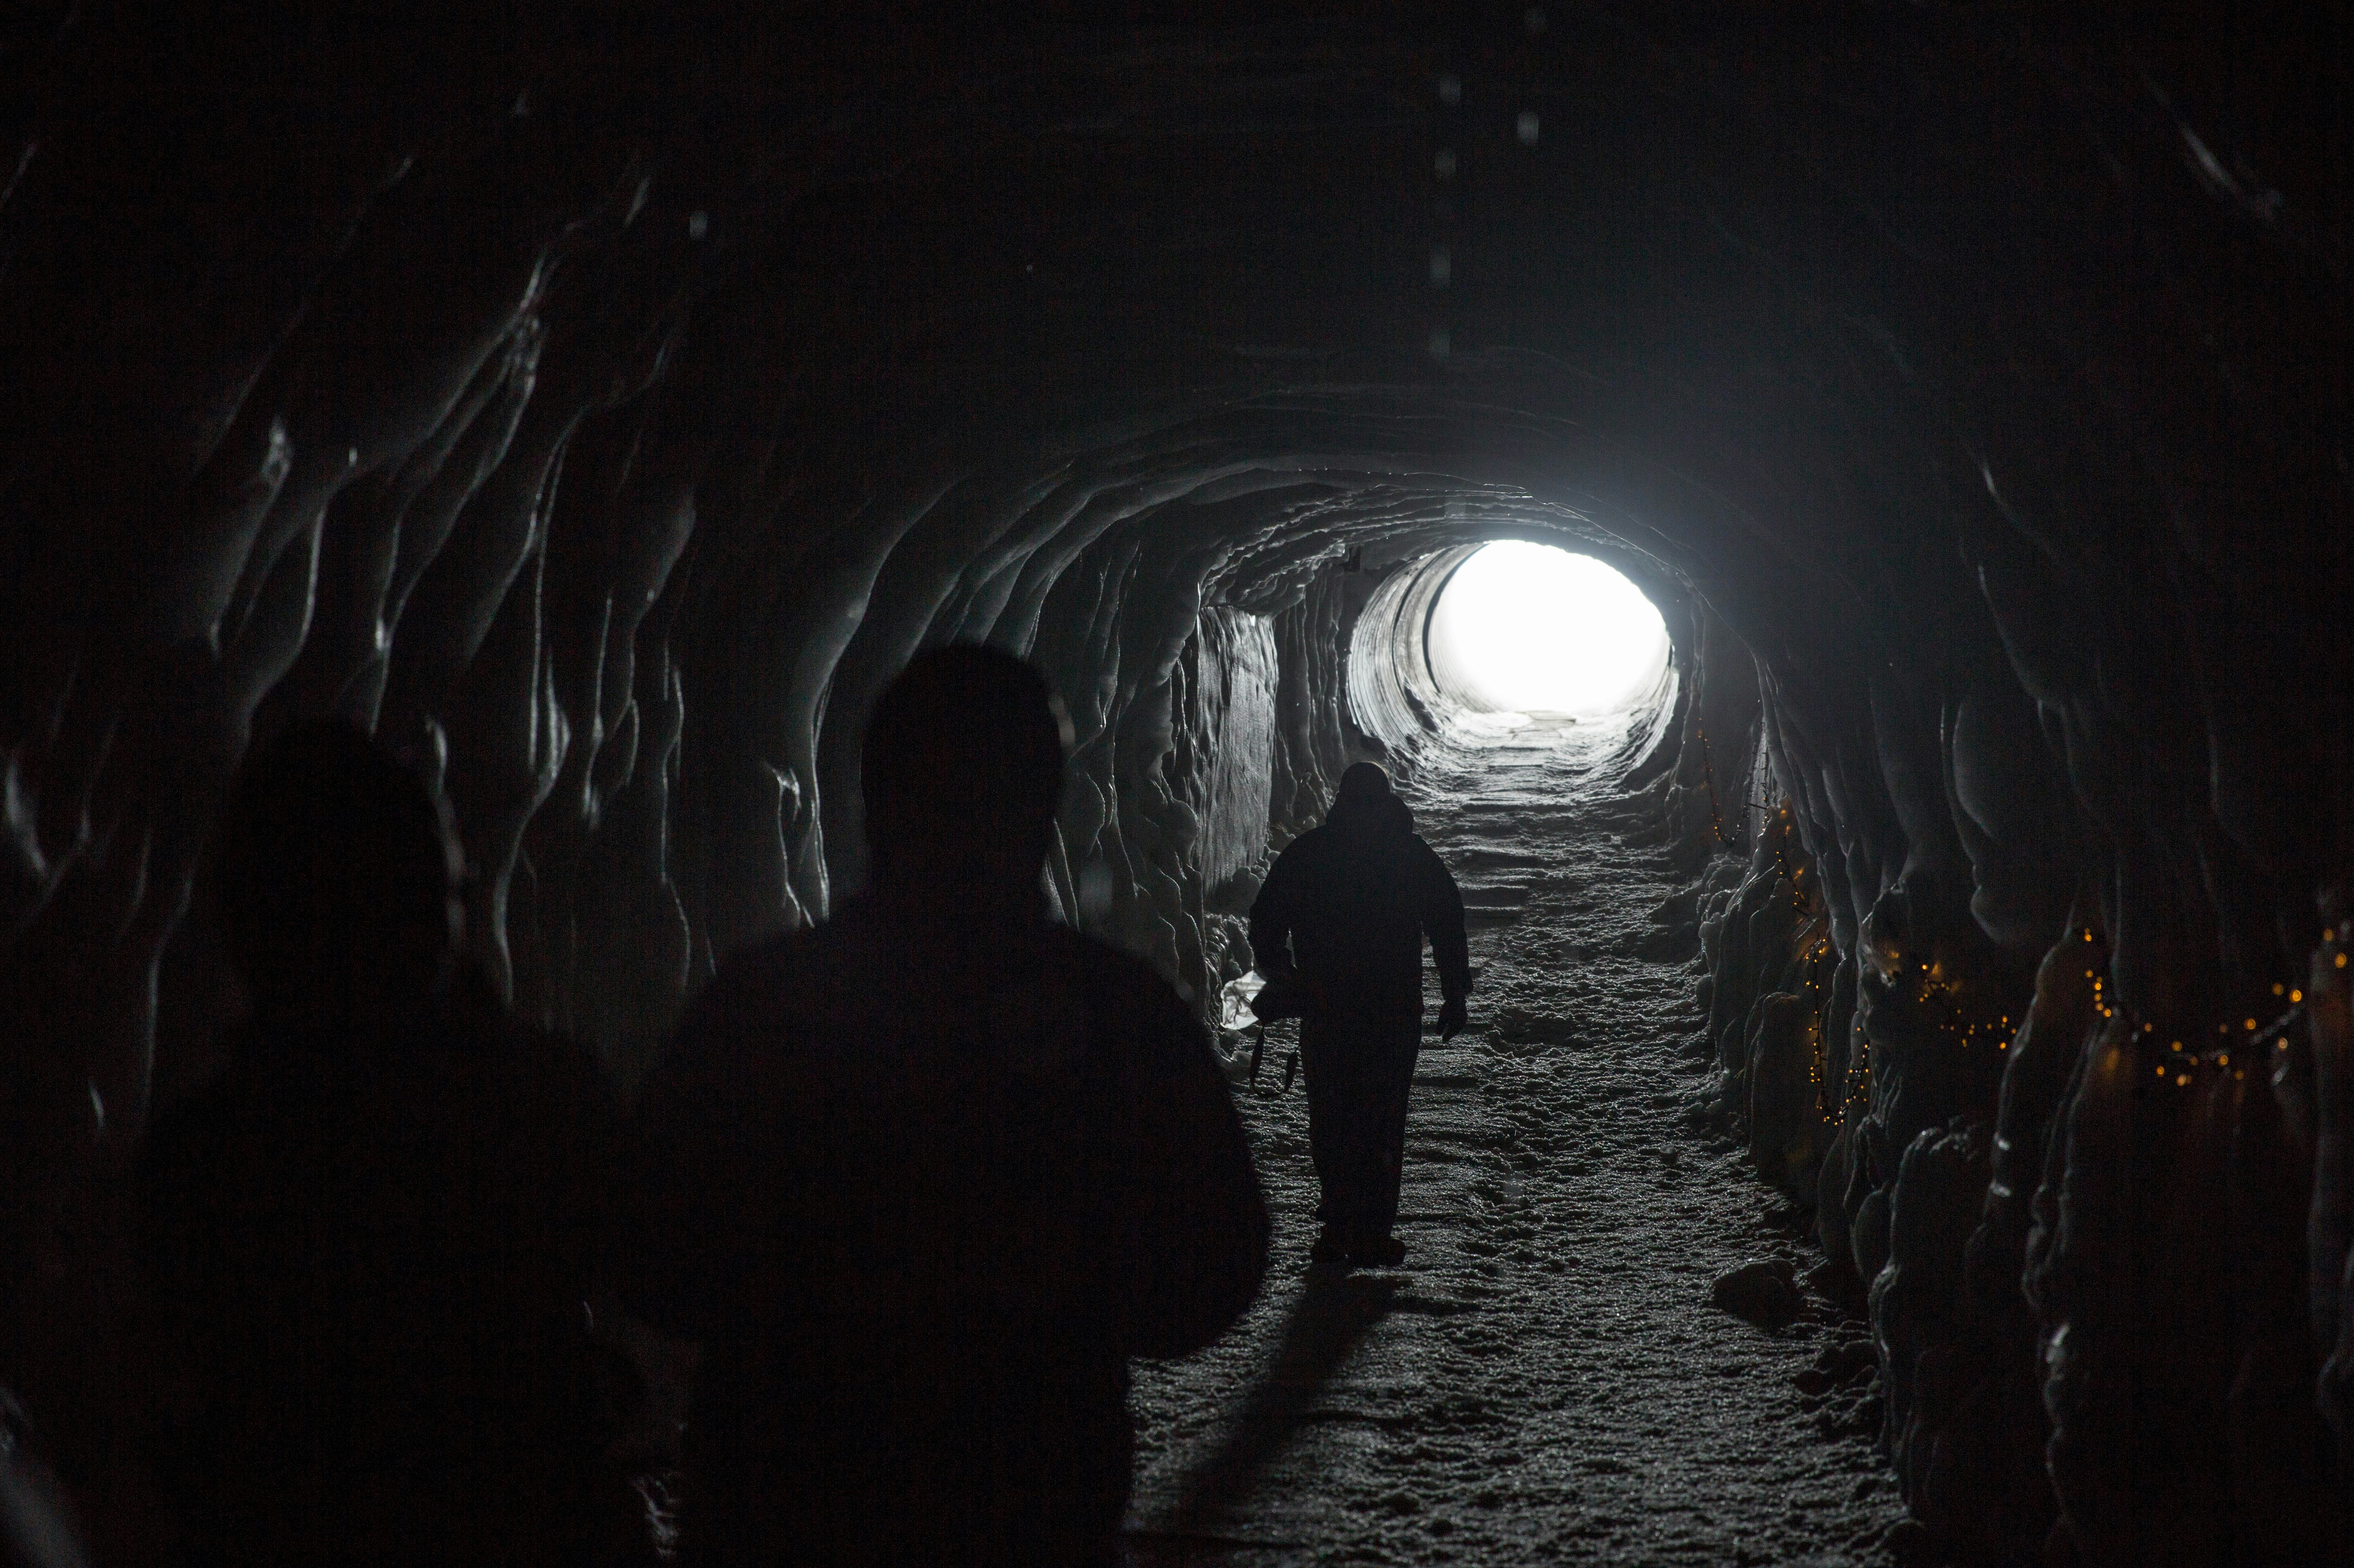
6.轉彎
Notes:
https://unsplash.com/photos/silhouette-of-three-person-walking-inside-tunnel-7EyZlDg1Q8M

Slide 8
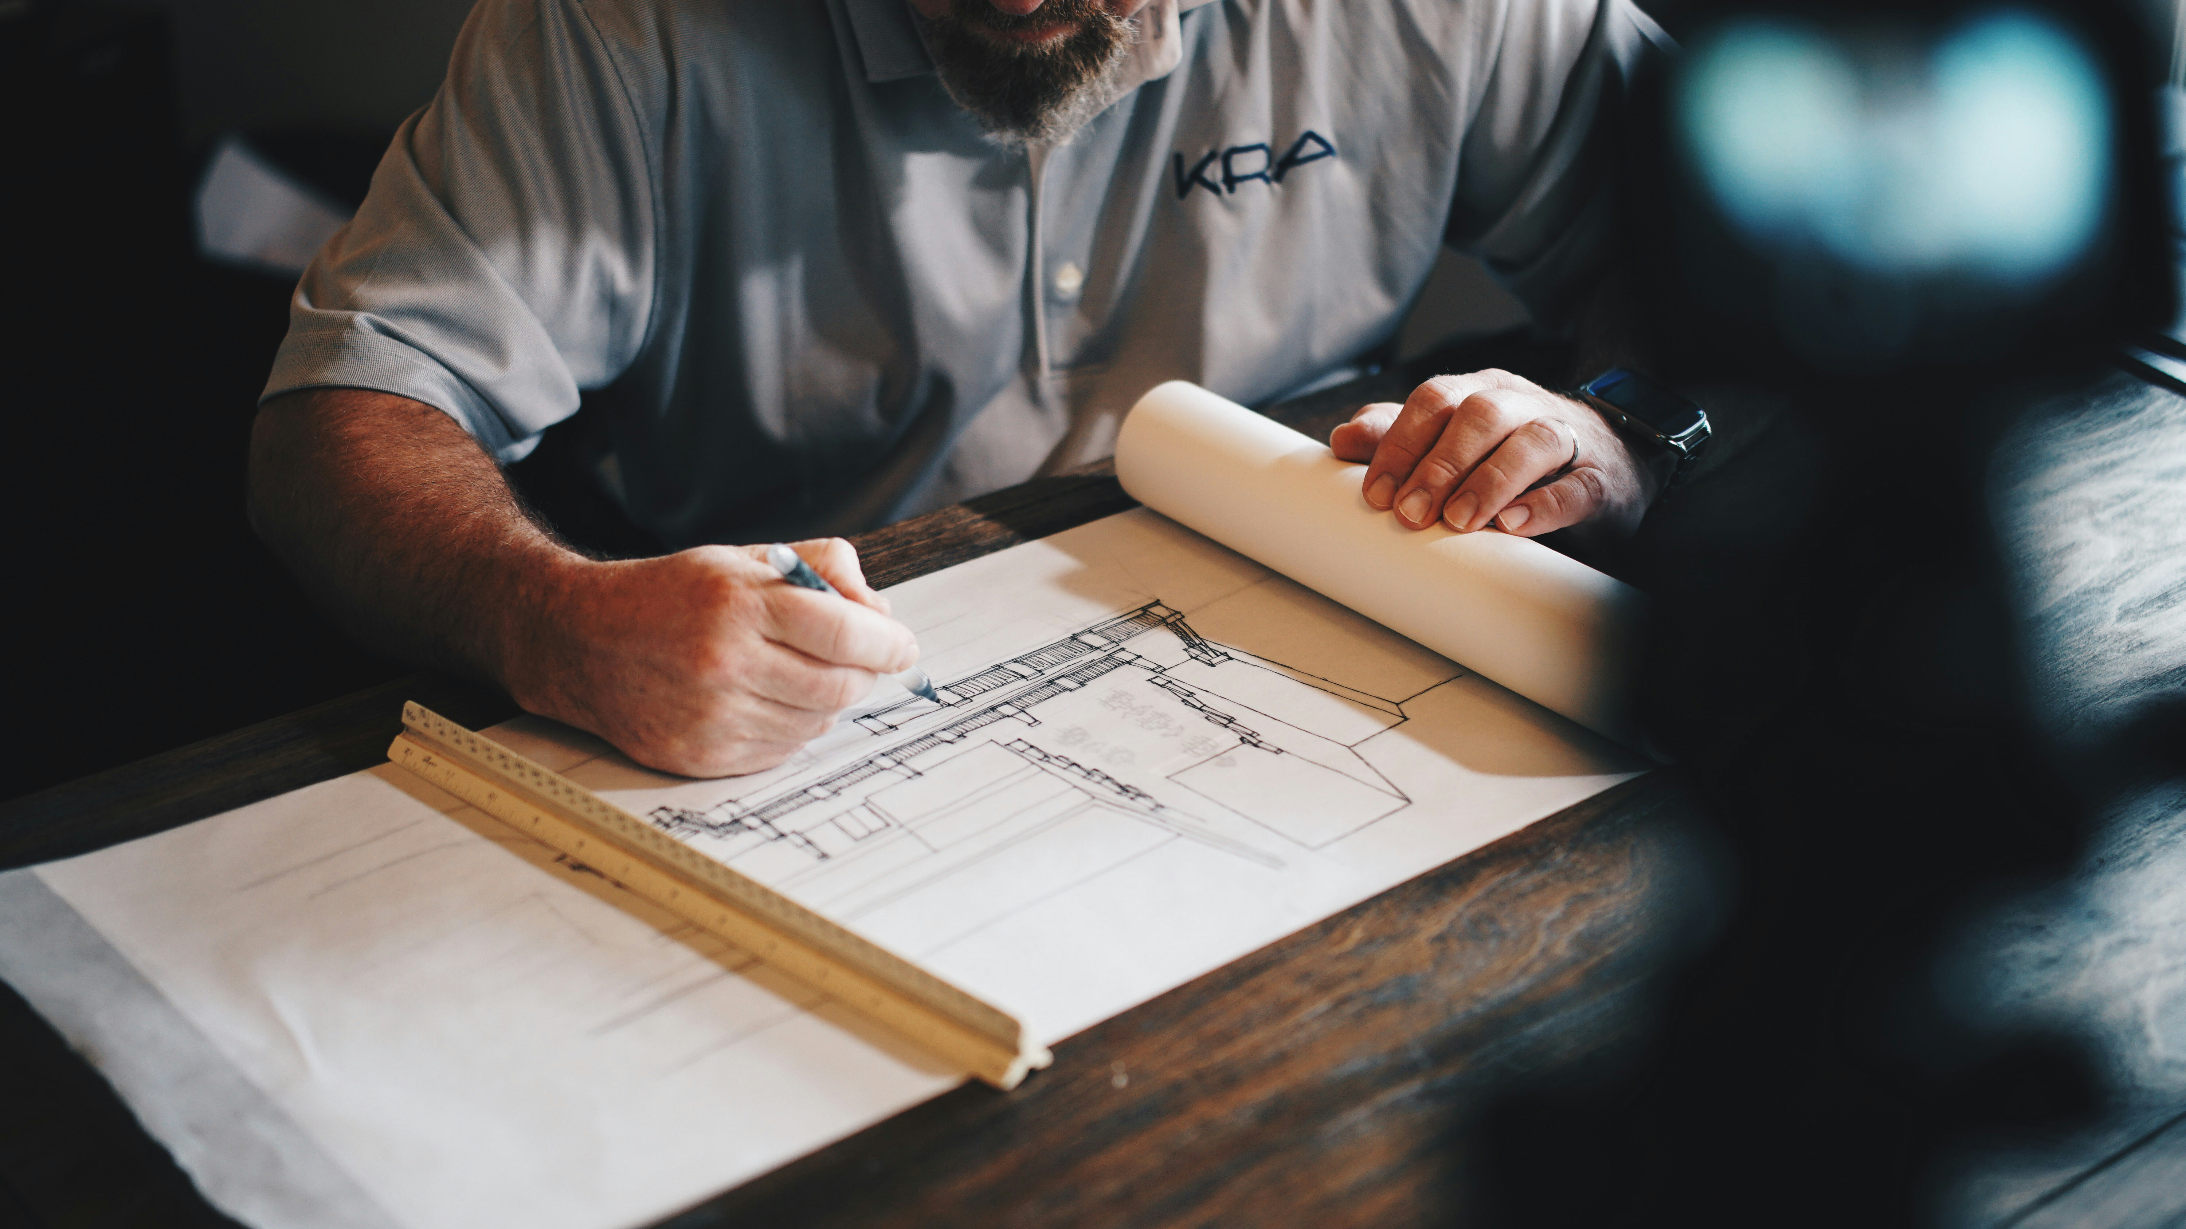
7.結局
Notes:
https://unsplash.com/photos/an-architect-working-on-a-draft-with-a-pencil-and-ruler-HtBlQdxfG9k

